Slide 1


It’s the question that drives us
It’s the question that brought you here. You know the question.
James R. Small, Sr. Architect at AT&T

Slide 2

What is the Matrix?
IPv4 and CGN combined to form a computer generated dream world
A prison for your mind where networking never changes

Slide 3

What is the problem?
Some are claiming IPv4 is not capable of continuing to support the Internet because of insufficient addressing capacity
Is this true?

Slide 4

Lets examine the situation
Questions to Answer:
What exactly is addressing supposed to do?
Where are we at with IPv4?
What would merit considering a replacement?
What happens if we do nothing?

Slide 5

What does IP addressing Provide?
Uniqueness - uniquely identify endpoints
Topology - identify the topological location an address may exist in
Registration - enable identification of party responsible for address (troubleshooting, security, etc.)
Routability - address may be routed on the Internet (reachable) in a scalable fashion
Operations - The combination of the above to provide operational simplicity including supporting applications/services

Slide 6
what is the capacity of IPV4?
IPv4 Addressing | Addresses | Notes
IPv4 address count | 4,294,967,296 | Theoretical limit (2³²)
Reserved addresses | 301,989,888 | 0.0.0.0/8, 127.0.0.0/8, 240.0.0.0/4
Multicast addresses | 268,435,456 | 224.0.0.0/3
Private addresses | 17,891,328 | RFC 1918 - 10.0.0.0/8, 172.16.0.0/12, 192.168.0.0/16
Shared Address Space (CGN) | 4,194,304 | RFC 6598 - 100.64.0.0/10
Benchmarking | 131,072 | RFC 2544 - 198.18.0.0/15
Link Local | 65,536 | RFC 3927 - 169.254.0.0/16
IANA special purpose | 1024 | RFC 6890 et. al. - 192.0.0.0/24, 192.31.196.0/24, 192.52.193.0/24, 192.88.99.0/24
Documentation/Test Nets | 768 | RFC 5737 - 192.0.2.0/24, 198.51.100.0/24, 203.0.113.0/24
Usable addresses | 3,702,257,920 | Available for general use

Slide 7
What is the usage for IPv4?

Slide 8
What is the usage for IPv4?

Slide 9
When does usage become a problem?
What is a reasonable host density for an addressing system?
RFC 3194 examines many addressing systems – networking and telecommunications – and reaches the following conclusions:
 | Reasonable (HD=80%) | Painful (HD=85%) | Very Painful (HD=86%) | Practical Maximum (HD=87%)
9-digit plan | 16,000,000 | 45,000,000 | 55,000,000 | 68,000,000
10-digit plan | 100,000,000 | 316,000,000 | 400,000,000 | 500,000,000
32-bit addressing | 51,000,000 | 154,000,000 | 192,000,000 | 240,000,000
HD = Host Density Ratio
Current Internet HD Ratio: 94.2%

Slide 10

So what happens with oversubscription?
Not possible to provide unique addressing, overloading (NAT) required
Topology, Registration and Routability are limited, don’t work or must use scopes
Operations become more complex
Applications/services require Application Layer Gateways or fixups to work with overloading
Some applications/services are incompatible with overloading

Slide 11

So what? We’ve been living with it…
Network challenges and complexities are fairly well understood
But…what about the application side?

Slide 12

Application Challenges with NAT
Simple applications such as basic E-mail and web sites generally work fine with NAT
Interactive applications or more complex/dynamic services typically require assistance to work through NAT – voice, video, games
What does it take to support NAT?

Slide 13

Application costs with NAT
Dealing with NAT and frameworks – 30+ RFCs
General approaches include:
STUN – Session Traversal Utilities for NAT
TURN – Traversal Using Relays around NAT
ICE – Interactive Connectivity Establishment
Approaches are per application/protocol
Thousands of pages of documentation, rules, suggestions, approaches
New RFCs/techniques continually appearing
Entire companies that specialize just in the middleware to support NAT Traversal

Slide 14

Life is tough, how do I make it work?
IPv4 Addresses are not unique – CGN or cascading NAT is pervasive
Make sure you don’t use addressing for authentication/authorization or anything else requiring uniqueness
Logging must include source/destination address/port and transport protocol (UDP/TCP); must also include very accurate time stamp (use NTP) as NAT correlations can change quickly

Slide 15

Can’t we extend IPv4 forever with Nat?
With traditional device types – desktops, laptops, servers, tablets, smartphones, printers, etc. – can probably extend IPv4 for some time, years
What happens when new categories of devices come online?

Slide 16

One of these protocols has a future, the other does not

Slide 17
Poll
How far can we oversubscribe IPv4 before it becomes too painful to use and support?
10x (37 billion Internet nodes)
100x (370 billion Internet nodes)
1,000x (3.7 trillion Internet nodes)
10,000x (37 trillion Internet nodes)
Point of Reference: From RFC 3194, practical maximum usage is 240 million nodes. So 10:1 oversubscription is over 154 times the recommended limit.

Slide 18

Look who’s coming to dinner…
The Internet of Things (IoT)
Devices designed to monitor, interact and react to surrounding environment (microcontrollers, sensors, actuators, etc.)
Many come with built-in networking, but not all…yet
By 2020, integrated networking will be ubiquitous due to plummeting costs
How many of these devices are there/will there be?

Slide 19
IoT device Growth
Net new microcontrollers (assuming steady state, not accounting for increased demand, new products, etc.):
Year | Units (Millions)
2013 | 16,131
2014 | 18,100
2015 | 19,417
2016 | 21,158
2017 | 21,585
2018 | 22,675

Slide 20
IoT device Growth
Net new sensors/actuators (assuming steady state, not accounting for increased demand, new products, etc.):
Year | Units (Billions)
2013 | 10.7
2014 | 12.4
2015 | 14.4
2016 | 17
2017 | 18.6
2018 | 20.5

Slide 21
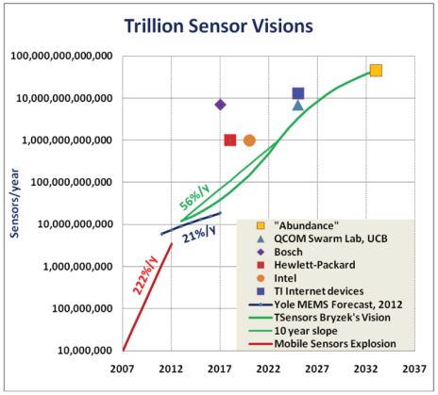
Stanford University’s Prediction

Slide 22
What does Iot need?
IoT Network Requirements
Must have low power demands
Must support lossy (unreliable) networks
Must be operationally simple
 | IPv4 | IPv6
Low Power? | No, protocol not designed for this | Yes – 6LoWPAN
Lossy Networks? | No, protocol not designed for this | Yes – 6LoWPAN
Simple Operations? | No, protocol not designed for this | Yes - Autoconfiguration

Slide 23

How does the industry see it?
IoT Networking Path
IETF – IPv6/6LoWPAN/6Lo
IEEE – IPv6
ACM – IPv6
Universities/Researchers – IPv6
Analysts (Gartner et. al.) – IPv6
Silicon Valley – IPv6
Home IoT (Zigbee) – IPv6 (6LoWPAN)
Bluetooth SIG – IPv6 (6LoWPAN)
ISPs/Carriers – IPv6
Networking Companies – IPv6
Operating Systems – IPv6

Slide 24
Does iot have practical uses today?
Solution Areas | Example Applications
Energy and Utilities | Smart Meters, SmartGrids
Building Automation | Demand Response, HVAC, Lighting, Surveillance, Security
Transportation | Connected Vehicles, Public Transportation, Freight & Containers, Logistics & Tracking
Retail | Vending Machine, PoS, Scanners, Kiosks
Healthcare | Medical Equipment, Remote Monitors, EHR Access, eOutpatient Care, Assisted Living, eHospital
Manufacturing | Industrial Process Control, PLC, Diagnostics, Energy Use Management

Slide 25

Consumer electronics show 2015
“…everything in your home is getting a chip or a sensor in the near future, even if the industry hasn't quite figured out how to tie it all together yet.”
Fashionable wearables with sophisticated health monitoring
Self-driving/parking cars – many demos
Advanced Driver Assistance Systems
Autonomous robots, drones and bots
Automation leveraging cloud-based analytics

Slide 26

Benefits – Money/time/safety/efficiency
Buildings are single largest consumer of power
Facilities energy management can save up to 40% of costs
Connected and Autonomous Vehicles
Logistics and Transportation Management
Real time parking assistance
Real time scheduling (book/swap/track)
Adaptive tracking/assistance (construction/traffic/legally parked)
Remote control
Real time EV charging station locator
Manufacturing Intelligence
Healthcare monitoring and assistance

Slide 27

who’s driving this?
Companies through new products
Consumers
Operations/Engineering/Facilities
Supported by Telecommunications Companies
But…Not IT!

Slide 28
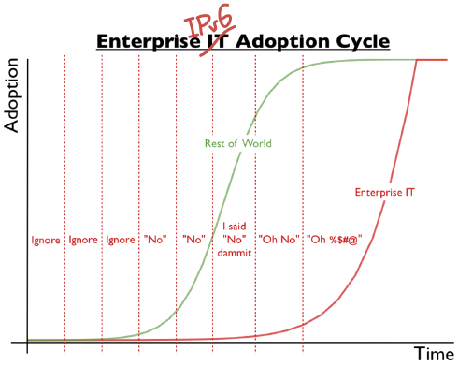
How does it view ipv6?

Slide 29

Why does it ignore ipv6?
Gartner sums it up nicely:
IPv6 current phase: Trough of Disillusionment
IPv6 business value/benefit: Low*
*But…needed for IoT initiatives and recommended for Internet access because of CGN problems

Slide 30

Disconnect
Facilities – Evaluating energy management solutions which may require IPv6
Engineering – Testing new systems/solutions using state of the art microcontrollers, sensors and actuators; expects universal connectivity
Operations – Looking at new manufacturing capabilities leveraging state of the art microcontrollers, sensors…
Common problem:
“What do you mean I can’t just use it (IPv6)? Why not? So can you have that fixed by tomorrow?”

Slide 31
Challenge
IT: “No one is asking for IPv6, therefore we don’t need it.”
Problem: Does your family ask for IPv4 or IPv6? Do they care? What if Facebook were only available via IPv6?
Many companies and industries see IoT initiatives as key parts of their strategy. This will require IPv6; but, are you sure this is understood?

Slide 32

The Internet has always been Ipv4…
Hasn’t the Internet always used IPv4?
Is it possible to transition to a new protocol (IPv6)?
Let’s examine history.

Slide 33
Internet evolution
1969 – Inception, First for nodes brought online
1970 – ARPANET switches to Network Control Protocol (NCP)
1974 – Vint Cerf and Bob Kahn public the initial design of TCP
1975 – Operation of Internet transferred to DCA (now DISA)
1978 – TCP split into TCP and IP; first SPAM message sent!
1981 – RFC 801 published, NCP/TCP Transition Plan
1982 – DCA standardizes Internet on TCP/IP
1983 – NCP “turned off”, Internet now IP only

Slide 34

Internet evolution
Question: What drove the migration from NCP to TCP/IP?
Answer: Applications
Question: Since NCP had many limitations which TCP/IP solved, were users/IT happy to switch?
Answer: No! Many resisted the change. DCA forced it. Users oblivious as long as their applications work.

Slide 35
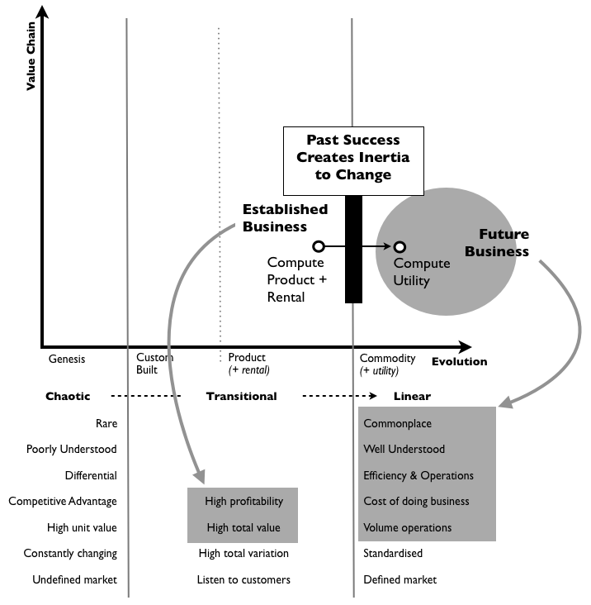
Iot will drive ipv6
Most will resist – the following may help illustrate:
From Simon Wardley’s
Bits or Pieces blog,
highly recommended!

Slide 36

Why are we resisting IPv6?
Why did an online book reseller capture the cloud market? How can that company now dominate this market space with all the “established” players scrambling to try to catch up?
Because we’re a victim of our own success. TCP/IP and specifically IPv4 is so successful and so commonplace that it literally is the Matrix. We can’t even see it any more.
Only people outside the industry who don’t understand “the rules” can see the need for something new and don’t care if it’s inconvenient.

Slide 37
who is driving ipv6?
IoT component producers (engineers)
Almost 20 billion net new units/year, increasing exponentially for several different categories (microcontrollers, sensors, actuators, etc.)
Need to support universal connectivity
“Those Internet/Networking People” have two standards, IPv4 and IPv6
IPv4 supports around 4 billion unique nodes
IPv6 supports virtually unlimited nodes
For an engineer who doesn’t understand “the rules”, the choice is obvious – IPv6
Decision has been made

Slide 38

So when do I need to support IPv6?
Confession:
I can’t predict the future.
Really irritates my clients…

Slide 39
Let’s look at IPv6 Adoption
How to measure IPv6?
How much traffic uses IPv6?
How many connections use IPv6?
How many routes are IPv6 routes?
How many service providers offer IPv6?
How many domain names have AAAA RRs?
How many domain NS’s use AAAA’s?
How many DNS queries are for AAAA RRs?
How many DNS queries are made over IPv6?
How many end devices have IPv6?
How many end devices use IPv6?
(and many more!)

Slide 40
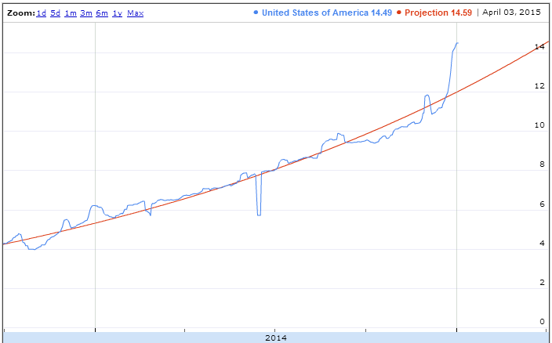
Let’s look at IPv6 Adoption
Best way is to measure end to end capability - can a user/endpoint connect to IPv6 site/service/app? This requires all the previously mentioned points…

Slide 41
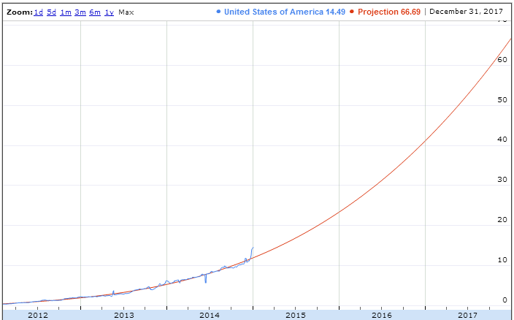
Where have we been/are we going?
Data from last 3 years; projection for next 3 years based on that:

Slide 42
what constitutes critical mass?
Aggressive: 10% penetration
Moderate: 15% penetration
Conservative: 20% penetration
Current penetration in US:
Approaching 15%
Will pass 20% well before the end of the year
Current number of IPv6 Internet Users in US:
34,083,812

Slide 43
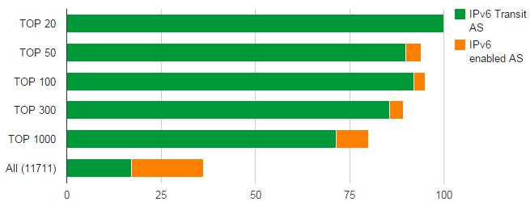
market indicators
What are Internet Service Providers doing?
Top Transit AS Overview

Slide 44
Major US Providers and ipv6 status
ISP/Service Provider | Traffic% which is IPv6
Google Fiber | 74.2%
Verizon Wireless | 63.2%
T-Mobile USA | 46.1%
Comcast | 30.3%
AT&T | 27.1%
CloudFlare | 21.6%
Hughes Network Systems | 21.3%
Hurricane Electric | 16.8%
Time Warner Cable | 12.4%

Slide 45
What about IPv4 address exhaustion?
Registry | Depletion Date | Available /8s | Status
IANA | Feb-11 | 0 | Exhausted
APNIC | Apr-11 | 0.7624 | Depleted
RIPE NCC | Sep-12 | 0.9711 | Depleted
LACNIC | Jun-14 | 0.2022 | Depleted
ARIN | Apr-15 | 0.4196 | Stage 4
AFRINIC | Apr-19 | 2.7922 | Normal

Slide 46
Do I really need IPv6?
Recommended because:
IoT will drive IPv6 – monitor this space carefully
Mobility moving to IPv6
Largest US Wireless Carrier – Verizon, majority of their traffic is IPv6, all 4G handsets must support IPv6
T-Mobile USA – New Android handsets are IPv6-only with 464XLAT for backwards compatibility with IPv4, but doesn’t work with everything
AT&T and Sprint have fully deployed IPv6 core; M2M networks are IPv6-only; only a matter of time before migrate to IPv6

Slide 47
Do I really need IPv6?
Recommended because:
All major US ISPs are deploying IPv6
Most major ISPs are also deploying CGN to conserve IPv4 address space
CGN breaks/degrades many applications – the content provider (read – you) will be blamed for problems
IPv4 Exhaustion increases pressure to migrate to IPv6
Silicon Valley/Technology leaders have long since deployed IPv6
Facebook moving to IPv6 only network
Start expecting enhanced features requiring IPv6

Slide 48

Remember, all I’m offering is the truth

Slide 49
Where do I start?
Lab – Unless you enjoy learning in production…
No lab budget? Home lab works too.
Goals:
Connectivity to IPv6 Internet
Allow remote access from IPv6 Internet
Allow option of making applications/services available from IPv6 Internet
Allow access to IPv6 Internet

Slide 50

proficiency requires practice

Slide 51

connectivity to IPv6 internet
Talk to your ISP about provisioning IPv6
Will require patience
15% of people having IPv6 means 85% don’t…
Much of ISP staff have little or no IPv6 experience
Not uncommon to hear:
“What’s that?”
“Why do you want that?”
“No one is using it.”

Slide 52
connectivity to IPv6 internet
Expectations for ISPs:
All Tier 1 and the vast majority of mid-range ISPs have deployed IPv6
If your ISP doesn’t offer IPv6 service you should look at switching providers
You may be able to find cheaper service which also includes IPv6
If your ISP talks about a surcharge for IPv6 you should look at switching providers, see above points
Exception – You may have to pay one time provisioning fees

Slide 53

connectivity to IPv6 internet
Expectations for ISPs:
Provision for native service
Try to avoid tunneled service – this is grounds for shopping
If your Internet access is through MPLS, 6PE or 6VPE is fine

Slide 54
connectivity to IPv6 internet
Deployment:
Single connection to ISP, assuming default route
Configuring IPv6 address and default route is easy
Make sure all your IPv4 security/controls are equivalent or acceptable for IPv6 – watch out for management access
Possible to do on your own but watch out for the above; make sure IPv6 configuration, features and functionality of equipment clearly understood
Multi-homed
Recommend getting help, even if it’s just to review your configuration and talk through it

Slide 55
connectivity to IPv6 internet
Equipment:
All major network/security vendors have long supported IPv6
Your equipment may not support IPv6 because:
Software upgrade needed
Hardware upgrade needed
Legacy solution, needs to be replaced
Solution:
Equipment under support contract, no additional costs for upgrade. Plan and execute.
Costs involved
Budget available – plan and execute
Budget not available – get in next year’s plan

Slide 56
allow remote access from IPv6 internet
Once connected to IPv6 Internet, look at setting up remote access
User Remote Access (VPN)
Site Remote Access (VPN)
More and more common for SOHO sites to be unable to obtain a public IPv4 address. This can be a problem for remote management. Solution – use IPv6.
Note: IPv6 VPN access still allows using IPv4 for the “inside” connection. This is the easy button for IPv6 remote access.

Slide 57
allow publishing to IPv6 internet
Full support of IPv6 for applications will take years, perhaps decades:
Operating system must support (all major ones do but requires configuration/testing)
Application platform/components must support (most major ones do but requires configuration/testing)
Application typically requires re-work (coding) to support IPv6
Database fields (32 bit → 128 bit fields)
User input/forms
Dealing with IPv6 DNS records
Address normalization, etc…

Slide 58
allow publishing to IPv6 internet
While application teams starting thinking about migrating to IPv6, an interim solution is required. Options:
NAT64
Appears to be easy button but complex to troubleshoot, limited flexibility, MTU problems difficult to solve/diagnose
Reverse Proxy
Workable solution for “proxyable” applications, performance/scale is the limiting factor
SLB64
Generally the best solution – supported by all major load balancer (ADC) solutions

Slide 59

allow access to IPv6 internet
For testing, development and potentially some Internet sites/applications/services. Options include:
Dual stack intranet
Ideal but typically a major project
Proxy
Good solution for “proxyable” applications (e.g. many web sites), as with reverse proxy – performance/scale is the bottleneck

Slide 60
allow access to IPv6 internet
For testing, development and potentially some Internet sites/applications/services. Options include:
Tunneling (e.g. ISATAP)
Can be a good solution for intranet lab access; more problematic for general use – can be difficult to troubleshoot/monitor; Reduced MTU can be an issue
VPN/Reverse VPN
Provide in-house or use service provider; similar issues to ISATAP; also potential loss of control depending on solution setup

Slide 61



Questions
?
My IPv6 Blogs:
Packet Pushers
@netsec14

Slide 62
Appendix
Notes:
Should be here around 35 minutes

Slide 63
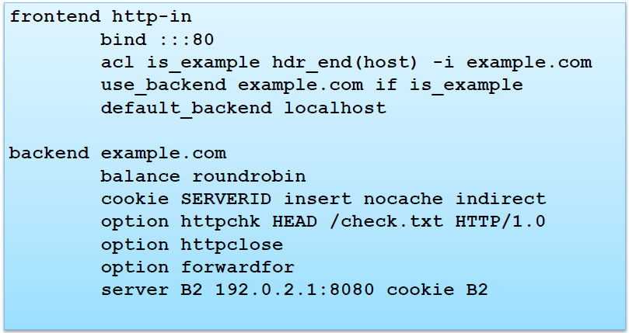
Example Software Proxy
HAPROXY
Example configuration (/etc/haproxy.cfg):
From Andrew Yourtchenko’s Cisco Live Preso (BRKRST-2304)

Slide 64
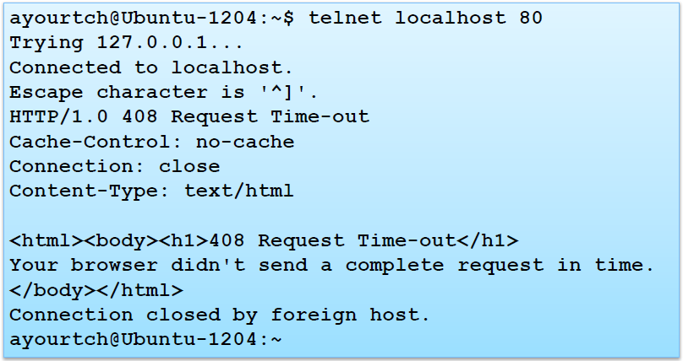
Example Software Proxy
HAPROXY – Connection Timeouts:
From Andrew Yourtchenko’s Cisco Live Preso (BRKRST-2304)

Slide 65
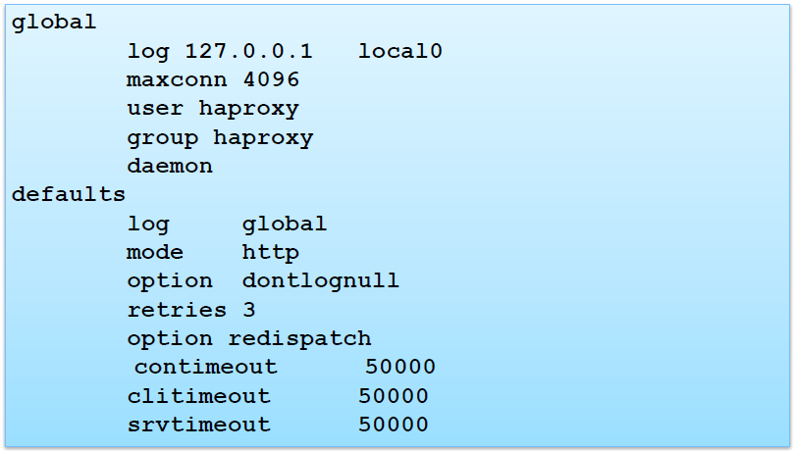
Example Software Proxy
HAPROXY – Connection Timeouts, test the defaults!
From Andrew Yourtchenko’s Cisco Live Preso (BRKRST-2304)

